Slide 1

Collision Domain and Broadcast Domain
Notes:
A domain is a type of computer network in which all user computers, printers accounts, and other devices registered. It is a central database located on single or multiple clusters of central computers, that is known as domain controllers.

Slide 2
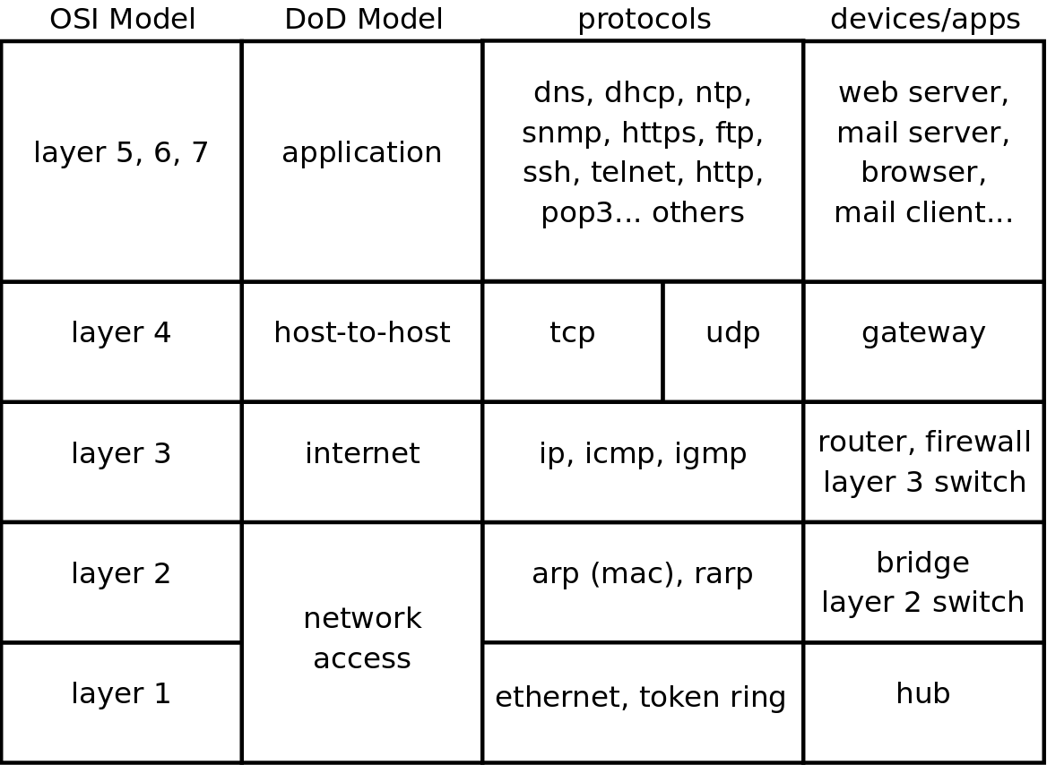
Network Devices
Layer 1
Repeaters, hubs, amplifiers, transceivers
Layer 2
Switches (traditional), bridges
Layer 3
Routers
NICs function at both layer 1 and 2
Notes:
Hub is a multiport repeater. It has multiple ports that accept Ethernet connections from different network devices. It is considered as the least intelligent device as it neither filters the data, nor it knows where the data is supposed to be sent. When a data packet arrives at one of the ports, it is copied to all of the other ports connected to it. As a result, all the devices receive the data packet, even if it is not for them.
A switch is smarter than a hub. Similar to the hub, it is a connection point for all the devices in the network. However, it is more efficient at passing a data packet across the network. It records the MAC addresses of the computers connected to it in a tabular format. When the data packet arrives, it reads the destination address and sends it to the appropriate system rather than sending it to all connected devices. If the destination address is not available, the switch sends the data packet to all the devices across the network.
A bridge works at the Data link layer (Layer 2) of the OSI model. It inspects incoming traffic and decide whether to forward it or filter it. Each incoming Ethernet frame is inspected for destination MAC address. If the bridge determines that the destination host is on another segment of the network, it forwards the frame to that segment. bridging connects two separate networks as if they were a single network
It is the most intelligent of the three networking devices. It is designed to understand, manipulate, and direct data packets based on their IP addresses. It connects a local area network (LANs) and wide area network (WANs) and features a dynamically updating routing table based on which they make decisions on routing data packets. When a data packet is received, it inspects the IP address and determines if the packet was meant for its network or not. If yes, then it receives the data packet, and if not then it sends it off to another network.

Slide 3
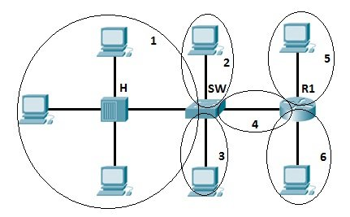
Collision Domains
Collision domains are segments of a network where collisions can potentially occur
Layer 1 devices extend collision domains
Layer 2 devices break up collision domains
Notes:
A collision domain is, as the name implies, the part of a network where packet collisions can occur. A collision occurs when two devices send a packet at the same time on the shared network segment. The packets collide and both devices must send the packets again, which reduces network efficiency. Collisions are often in a hub environment, because each port on a hub is in the same collision domain.

Slide 4
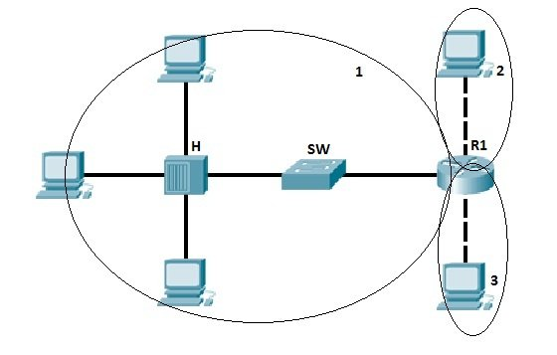
Broadcast Domains
Nodes on the same LAN exchange data by sending frames
Each frame contains a source and destination MAC address to define the sender and receiver
Broadcast frames are received by all devices
Layer 1 and 2 devices extend broadcast domains
Layer 3 devices break up broadcast domains
Notes:
A broadcast domain is the domain in which a broadcast is forwarded. A broadcast domain contains all devices that can reach each other at the data link layer (OSI layer 2) by using broadcast. All ports on a hub or a switch are by default in the same broadcast domain. All ports on a router are in the different broadcast domains and routers don’t forward broadcasts from one broadcast domain to another.

Slide 5
Switches
Switches examine the MAC addresses of frames to determine forwarding decisions
Unlike hubs, which simply forward all frames out of ports
Switches only send frames out of the port which is connected to the destination
Hence they break up collision domains
Switches send broadcast frames out of all ports aside from the port the frame came in
Hence they extend broadcast domains

Slide 6
Switches – Bridging Tables
Switches associate interfaces (ports) to MAC addresses in a bridging table
The bridging table is empty when a switch is first connected
When a frame is received on a given interface, the switch associates the source MAC address with that interface
If a switch sees an unknown destination MAC address, it forwards the frame on all ports aside from the source port (“flooding”)

Slide 7
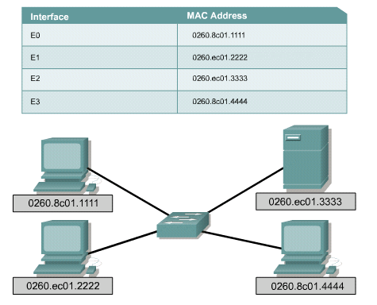
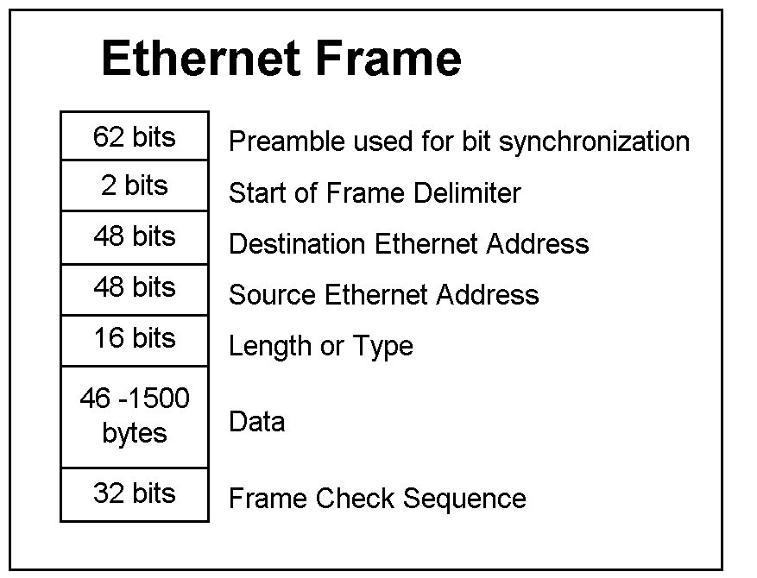
Switches – Bridging Tables

Slide 8
Switches – Forwarding Decisions
Store-and-Forward
The switch waits until it has received the entire frame and can verify that it’s valid before forwarding
Slow, but error free
Cut through
The switch begins forwarding the frame as soon as it sees the destination MAC address
Fast, but errors are passed on
Fragment free
The switch waits until it receives the whole frame header before forwarding
Slower than cut through, but catches some errors

Slide 9
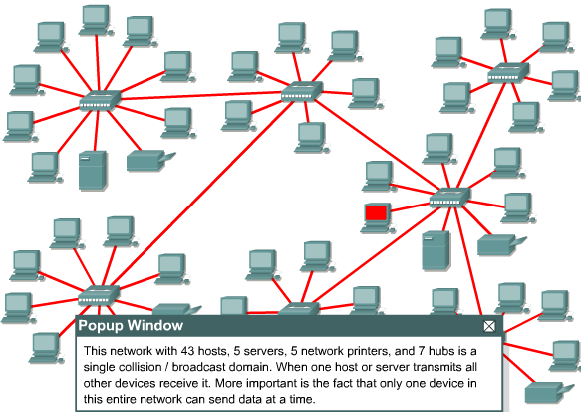
Collisions in Collision Domain
If your Internet router has hub ports instead of switched ports this is why it slows down when you connect a few extra computers

Slide 10
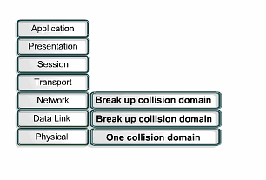
Collision Domain Segmentation

Slide 11
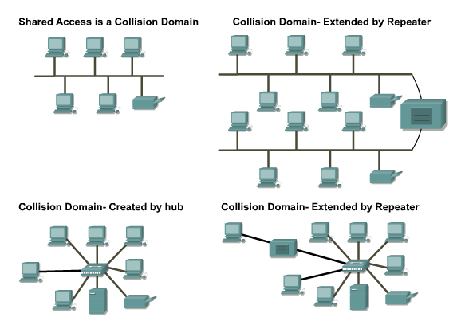
Layer 1 Devices Extend Collision Domains

Slide 12
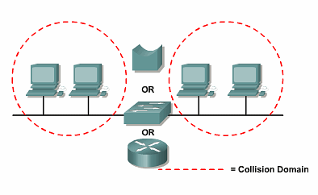
Limiting the Collision Domains

Slide 13
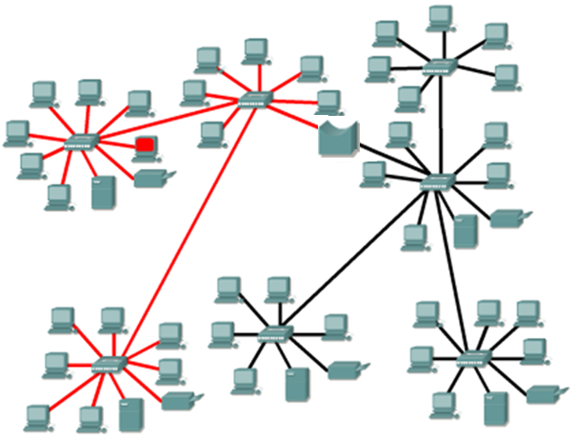
Limiting the Collision Domains With a bridge

Slide 14
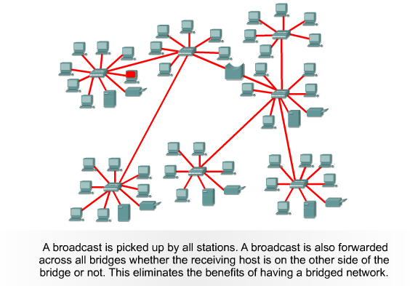
Broadcasts in a Bridged Environment

Slide 15
Routers
Routers are a layer 3 (Network layer) device
Routers connect networks
Routers building routing tables to all known destination networks by exchanging their routing tables with adjacent routers.
Routers select the best path for incoming data packets to reach their destination networks

Slide 16
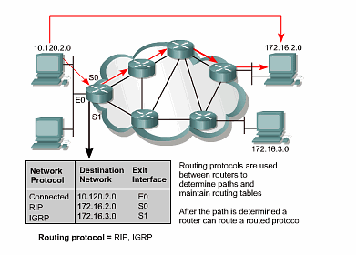
Routing

Slide 17
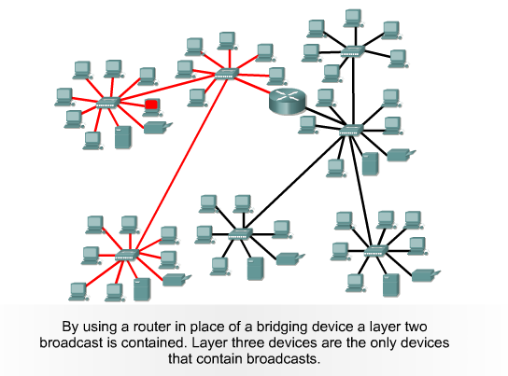
Broadcast Domain Segmentation

